Slide 1
Module 5
Shift registers: Shift registers – Serial In Serial Out, Serial In Parallel Out, Bidirectional Shift Register with Parallel load. Ring counter. Johnson counter- timing sequences and state diagrams.
Arithmetic algorithms: Algorithms for addition and subtraction of binary numbers in signed magnitude and 2’s complement representations. Algorithm for addition and subtraction of BCD numbers. Representation of floating point numbers, Algorithm for addition and subtraction of floating point numbers.
Programmable Logic devices: ROM. Programmable Logic Array(PLA)- Implementation of simple circuits using PLA.

Slide 2
We know that one flip-flop can store one-bit of information.
In order to store multiple bits of information, we require multiple
flip-flops.
The group of flip-flops, which are used to hold or store the binary data is known as register.
If the register is capable of shifting bits either towards right hand side or towards left hand side is known as shift register.
An ‘N’ bit shift register contains ‘N’ flip-flops.
Following are the four types of shift registers based on applying inputs and accessing of outputs.
Serial In − Serial Out shift register
Serial In − Parallel Out shift register
Parallel In − Serial Out shift register
Parallel In − Parallel Out shift register
The shift register circuit which is capable of shifting the data in both the direction - Bidirectional shift register.
The shift register circuit which is capable of doing all the four types of shift operations is called Universal Shift Register also called Bidirectional shift register with parallel load.

Slide 3
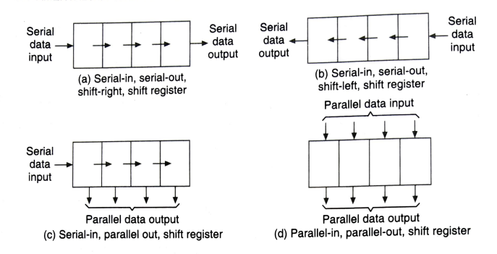
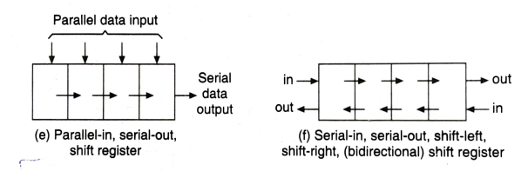
Types of shift Registers

Slide 4
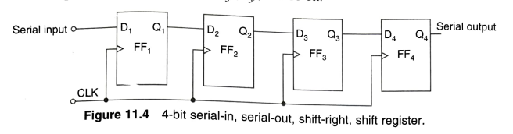
SERIAL-IN, SERIAL-OUT, SHIFT REGISTER

Slide 5
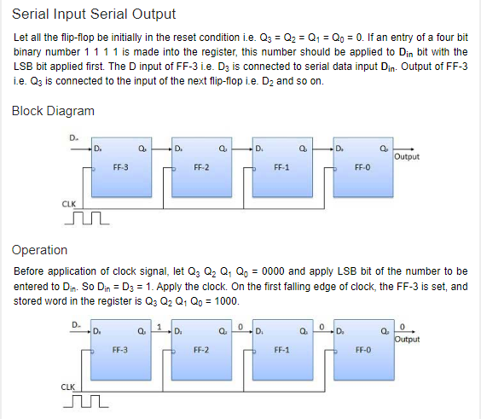
Working

Slide 6
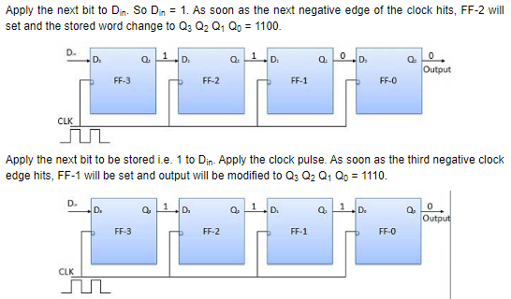

Slide 7
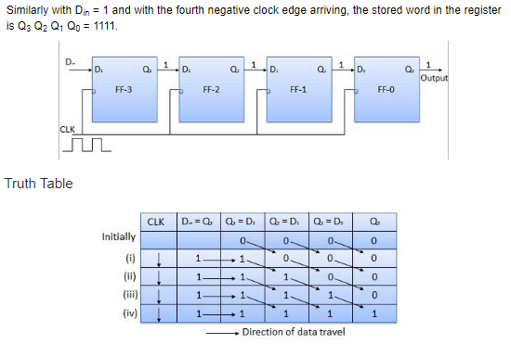

Slide 8
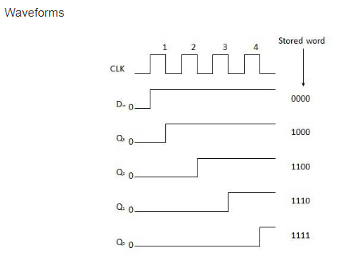

Slide 9
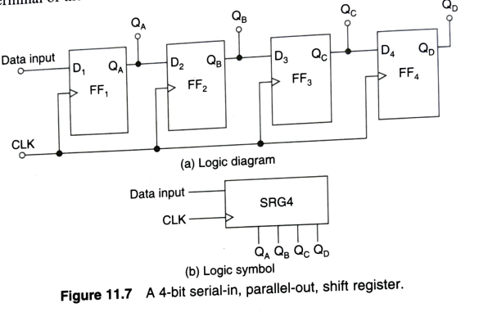
SERIAL-IN, PARALLEL-OUT, SHIFT REGISTER

Slide 10
In such types of operations, the data is entered serially and taken out in parallel fashion.
Data is loaded bit by bit. The outputs are disabled as long as the data is loading.
As soon as the data loading gets completed, all the flip-flops contain their required data, the outputs are enabled so that all the loaded data is made available over all the output lines at the same time.
4 clock cycles are required to load a four bit word. Hence the speed of operation of SIPO mode is same as that of SISO mode.

Slide 11

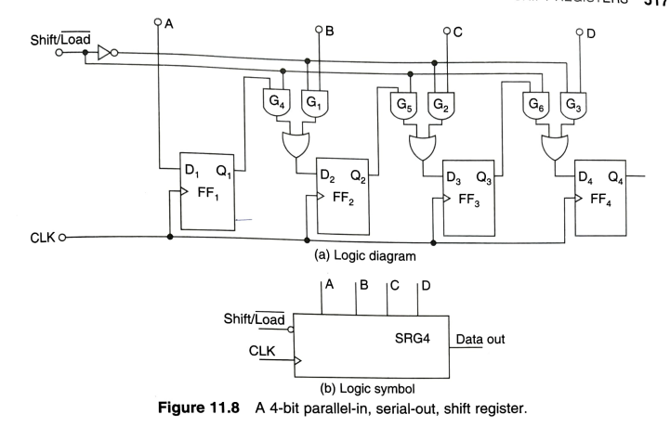
PARALLEL-IN,SERIAL OUT SHIFT REGISTERS

Slide 12
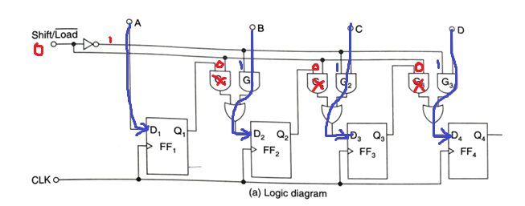
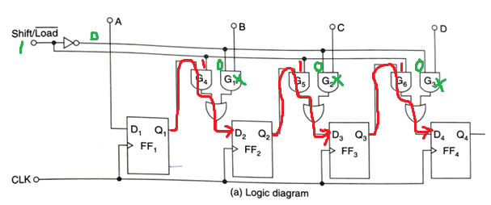
When shift/load= 0, all the data will enter into the shift register parallelly
When shift/load= 1, all the data will shift right upon the clock cycle

Slide 13
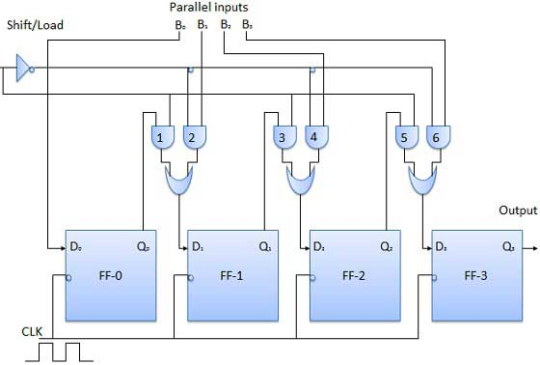
Parallel Input Serial Output (PISO)
Data bits are entered in parallel fashion.
The circuit shown below is a four bit parallel input serial output register.
Output of previous Flip Flop is connected to the input of the next one via a combinational circuit.
The binary input word B₀, B₁, B₂, B₃ is applied though the same combinational circuit.
There are two modes in which this circuit can work namely - shift mode or load mode.
Load mode-When the shift/load bar line is low (0), the AND gate 2, 4 and 6 become active they will pass B₁, B₂, B₃ bits to the corresponding flip-flops. On the low going edge of clock, the binary input B₀, B₁, B₂, B₃ will get loaded into the corresponding flip-flops. Thus parallel loading takes place.
Shift mode- When the shift/load bar line is low (1), the AND gate 2, 4 and 6 become inactive. Hence the parallel loading of the data becomes impossible. But the AND gate 1,3 and 5 become active. Therefore the shifting of data from left to right bit by bit on application of clock pulses. Thus the parallel in serial out operation takes place.

Slide 14
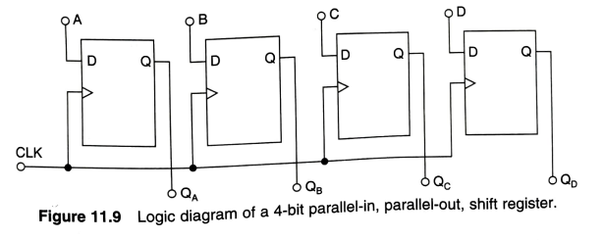
In this mode, the 4 bit binary input B₀, B₁, B₂, B₃ is applied to the data inputs D₀, D₁, D₂, D₃ respectively of the four flip-flops.
As soon as a negative/positive clock edge is applied, the input binary bits will be loaded into the flip-flops simultaneously.
The loaded bits will appear simultaneously to the output side. Only clock pulse is essential to load all the bits.

Slide 15
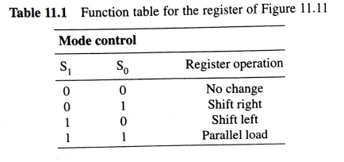
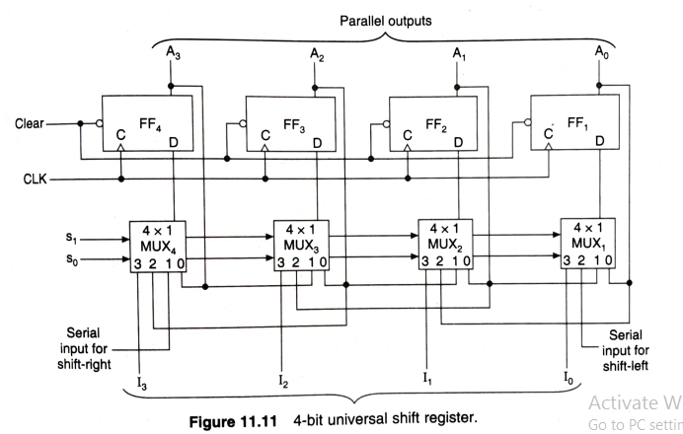
UNIVERSAL SHIFT REGISTERRS
(Bidirectional Shift Register with Parallel load)
0
1
2
3

Slide 16
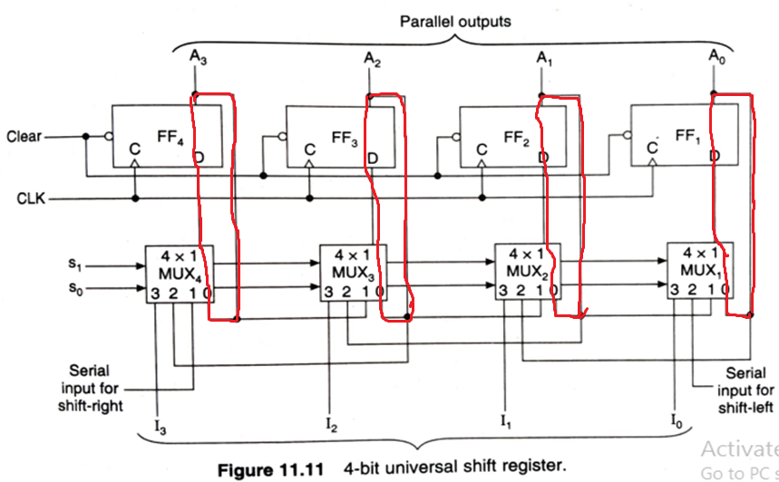
S1=S0=0; No change condition
0
0
0
0
0
0
0
0

Slide 17
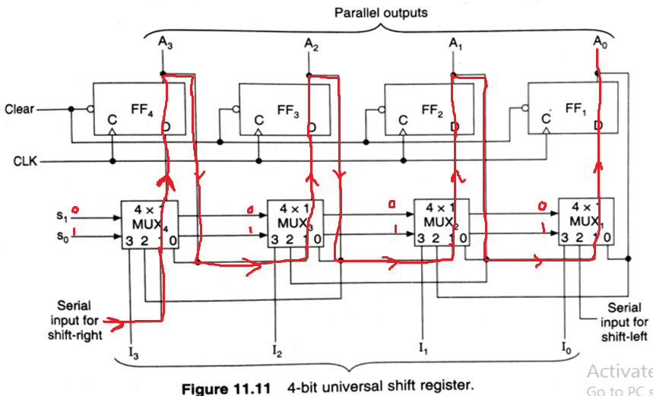
S1=0,S0=1; Shift Right
Data

Slide 18
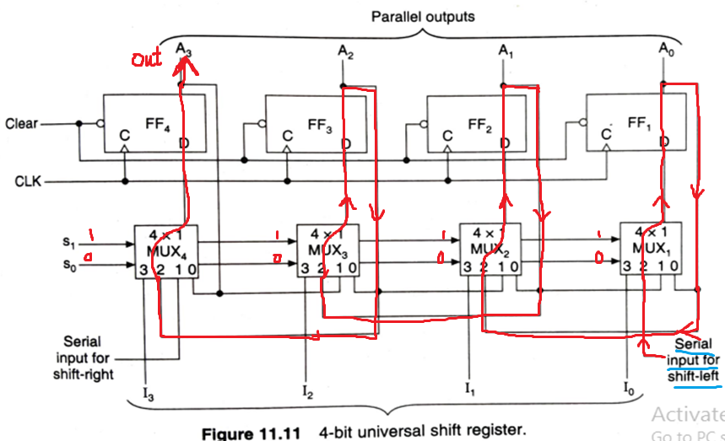
S1=1,S0=0; Shift left

Slide 19
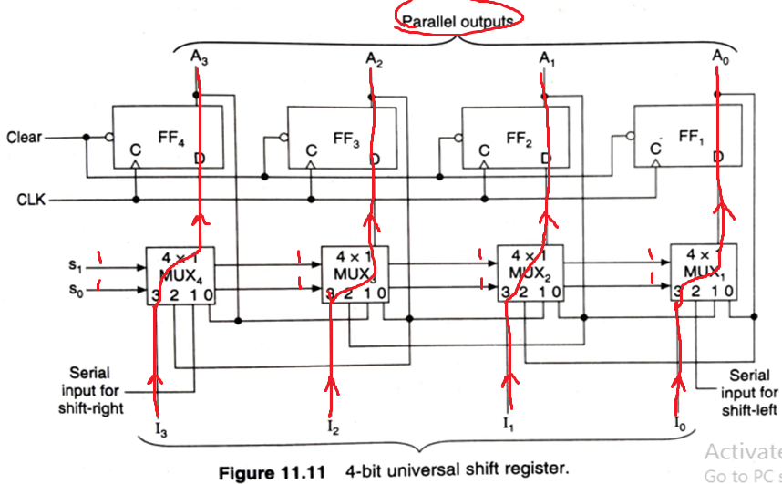
S1=1,S0=1; Parallel Load

Slide 20
Shift Register Counters
Ring counter: A ring counter is a typical application of the Shift register. The ring counter is almost the same as the shift counter. The only change is that the output of the last flip-flop is connected to the input of the first flip-flop in the case of the ring counter but in the case of the shift resister it is taken as output. So, for designing a 4-bit Ring counter we need 4 flip-flops.
The clock pulse (CLK) is applied to all the flip-flops simultaneously, ie. it works synchronously. It is also a synchronous counter.

Slide 21
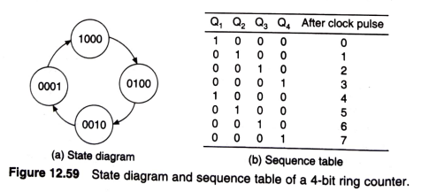
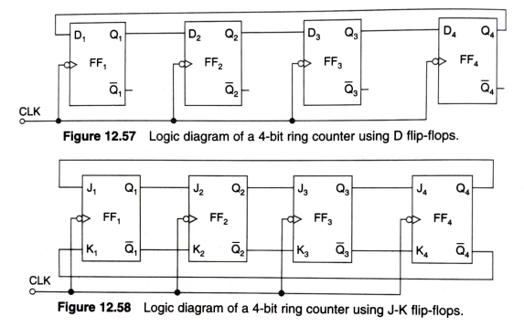
Ring Counter

Slide 22
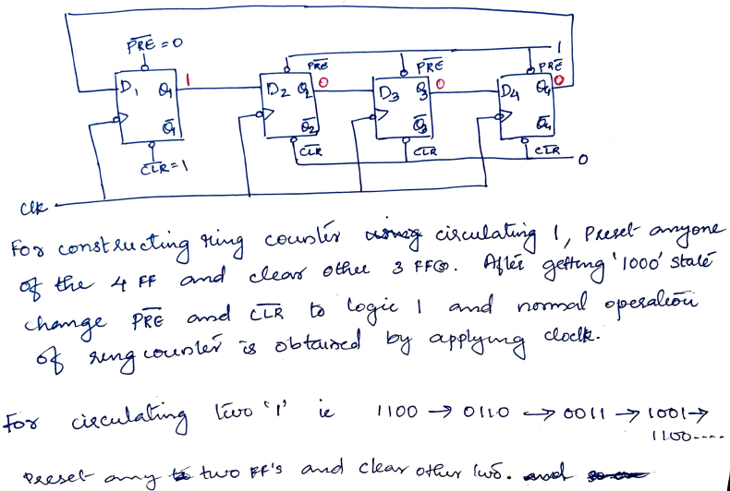

Slide 23
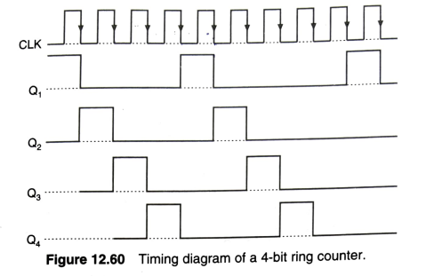

Slide 25

2.Johnson counter : Another application of shift register counter. It is also a synchronous counter. In Johnson counter, the complemented output of last flip flop is connected to input of first flip flop and to implement n-bit Johnson counter we require n flip-flop. It is one of the most important type of shift register counter. Another name of Johnson counter is twisted ring counter.
n is the no. of FF

Slide 26
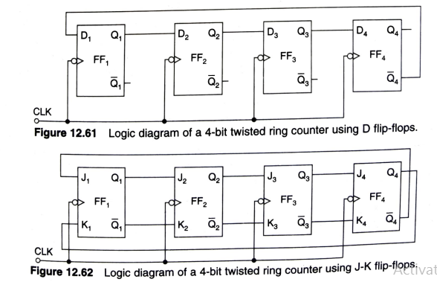
Twisted Ring Counter (Johnson Counter)

Slide 27
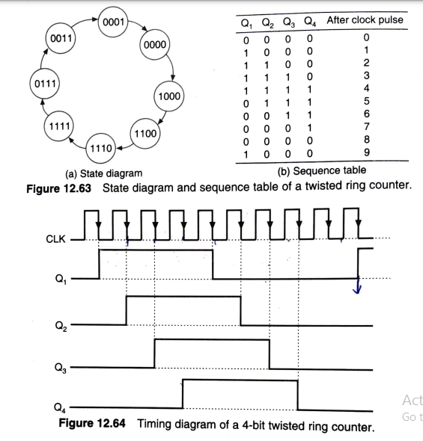

Slide 28
Programmable Logic devices
1.ROM.
2.Programmable Logic Array(PLA)- Implementation
of simple circuits using PLA.

Slide 29
Programmable Logic Devices PLDs
PLDs are the integrated circuits. They contain an array of AND gates & another array of OR gates.
There are three kinds of PLDs based on the type of arrays, which has programmable feature.
Programmable Read Only Memory(Mentioned in the syllabus)
Programmable Array Logic
Programmable Logic Array (Mentioned in the syllabus)
The process of entering the information into these devices is known as programming. Basically, users can program these devices or ICs electrically in order to implement the Boolean functions based on the requirement. Here, the term programming refers to hardware programming , not the software programming.

Slide 30
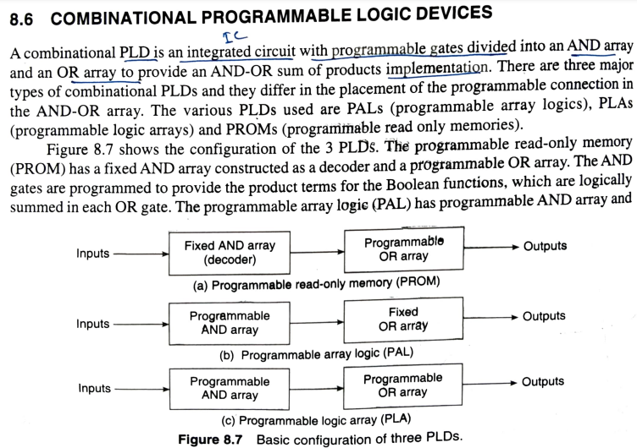

Slide 31
Programmable Read Only Memory (PROM)
Read Only Memory (ROM) is a memory device, which stores the
binary information permanently.
That means, we can’t change that stored information by any means later.
If the ROM has programmable feature, then it is called as Programmable ROM (PROM).
The user has the flexibility to program the binary information electrically once by using PROM programmer.
PROM is a programmable logic device that has fixed AND array &
Programmable OR array. The block diagram of PROM is shown
in the following figure.

Slide 32
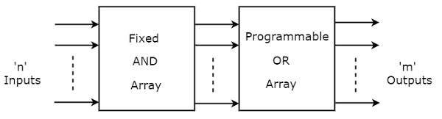
Here, the inputs of AND gates are not of programmable type. So, we have to generate 2^{n} product terms by using 2^{n} AND gates having n inputs each. We can implement these product terms by using nx2^{n} decoder. So, this decoder generates 2^{n} min terms.
Here, the inputs of OR gates are programmable. That means, we can program any number of required product terms, since all the outputs of AND gates are applied as inputs to each OR gate. Therefore, the outputs of PROM will be in the form of sum of min terms.

Slide 33
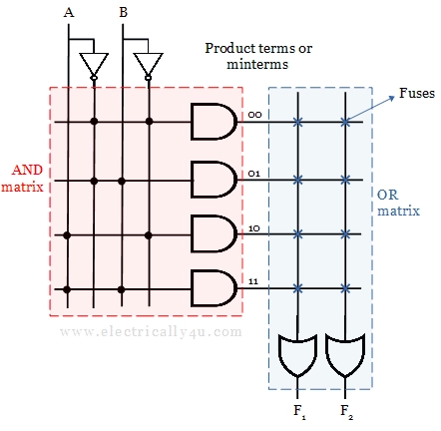
Logic diagram of PROM

Slide 34
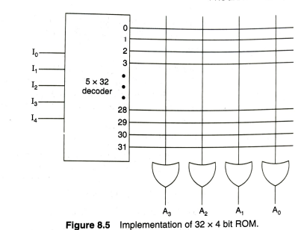
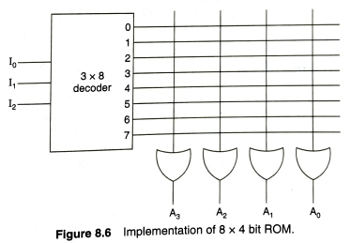

Slide 35
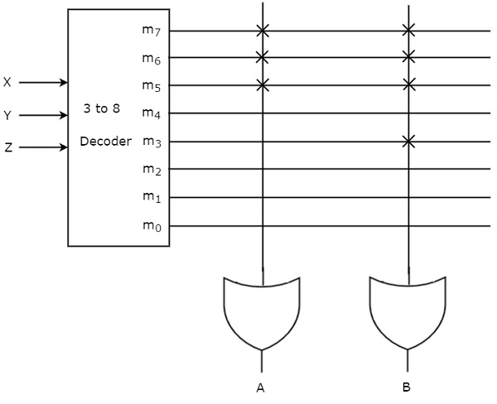
Example
Let us implement the following Boolean functions using PROM.
A(X,Y,Z)=∑m(5,6,7)
B(X,Y,Z)=∑m(3,5,6,7)
The given two functions are in sum of min terms form and each function is having three variables X, Y & Z. So, we require a 3 to 8 decoder and two programmable OR gates for producing these two functions. The corresponding PROM is shown in the following figure.
Here, 3 to 8 decoder generates eight min terms. The two programmable OR gates have the access of all these min terms. But, only the required min terms are programmed in order to produce the respective Boolean functions by each OR gate. The symbol ‘X’ is used for programmable connections.

Slide 36
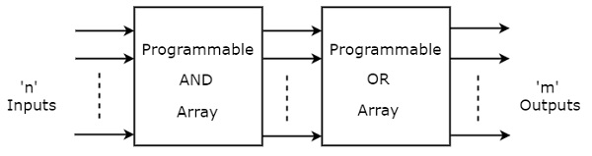
Programmable Logic Array (PLA)
PLA is a programmable logic device that has both Programmable AND array & Programmable OR array. Hence, it is the most flexible PLD. The block diagram of PLA is shown in the following figure.
Here, the inputs of AND gates are programmable. That means each AND gate has both normal and complemented inputs of variables. So, based on the requirement, we can program any of those inputs. So, we can generate only the required product terms by using these AND gates.
Here, the inputs of OR gates are also programmable. So, we can program any number of required product terms, since all the outputs of AND gates are applied as inputs to each OR gate. Therefore, the outputs of PAL will be in the form of sum of products form.

Slide 37
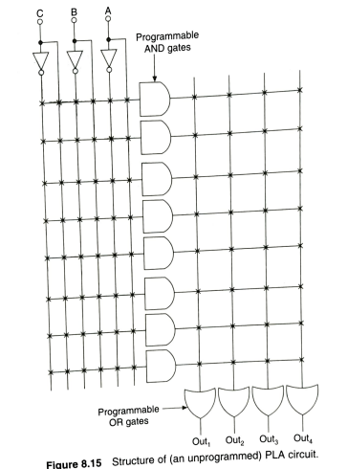

Slide 38
Example
Let us implement the following Boolean functions using PLA.
A=XY+XZ′
B=XY′+YZ+XZ′
The given two functions are in sum of products form. The number of product terms present in the given Boolean functions A & B are two and three respectively. One product term, Z′X is common in each function
So, we require four programmable AND gates & two programmable OR gates for producing those two functions.
The corresponding PLA is shown in the following figure.

Slide 39
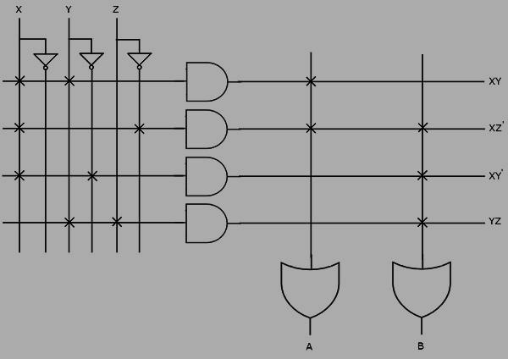
Example
Let us implement the following Boolean functions using PLA.
A=XY+XZ′
B=XY′+YZ+XZ′

Slide 40
The programmable AND gates have the access of both normal and complemented inputs of variables. In the above figure, the inputs X, X′, Y, Y′, Z & Z′, are available at the inputs of each AND gate.
So, program only the required literals in order to generate one product term by each AND gate.
All these product terms are available at the inputs of each programmable OR gate.
But, only program the required product terms in order to produce the respective Boolean functions by each OR gate.
The symbol ‘X’ is used for programmable connections.

Slide 41
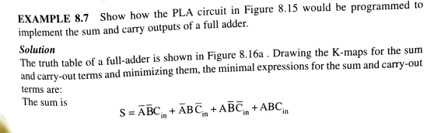
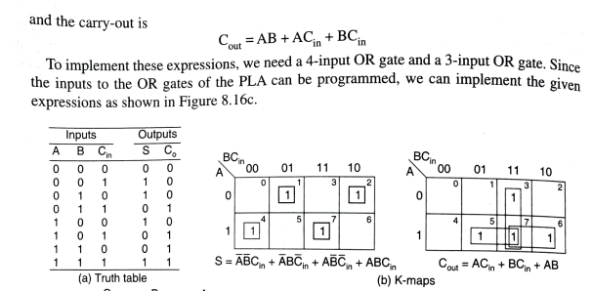

Slide 42
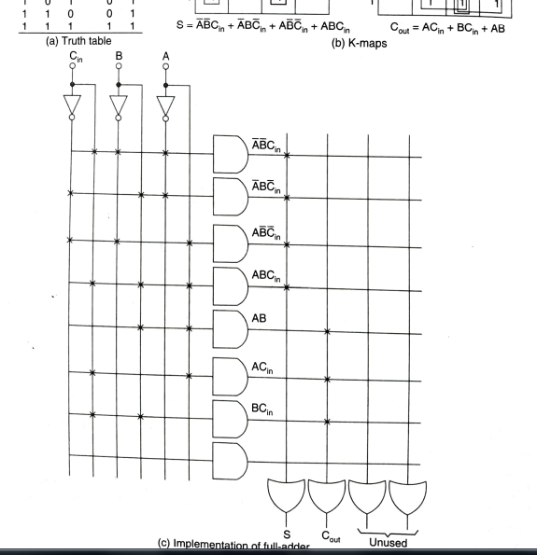

Slide 43
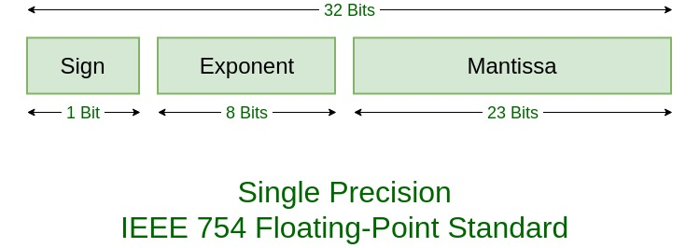
Representation of floating point numbers
Most of the binary floating-point representations follow the IEEE-754 standard.
The data type float uses IEEE 32-bit single precision format and the data type double uses IEEE 64-bit double precision format.
Single precision numbers include an 8-bit exponent field and a 23-bit fraction, for a total of 32 bits.
The sign bit is 0 for positive numbers and 1 for negative numbers. The exponent range for normalized numbers is [−126, 127] for single precision.

Slide 44
Example: 85.125
85 = 1010101
0.125 = 001
85.125 = 1010101.001
=1.010101001 x 2^6
sign = 0
1. Single precision:
biased exponent 127+6=133
133 = 10000101
Normalised mantissa = 010101001
we can add 0's to complete the 23 bits.
The IEEE 754 Single precision is:
= 0 10000101 01010100100000000000000

Slide 45
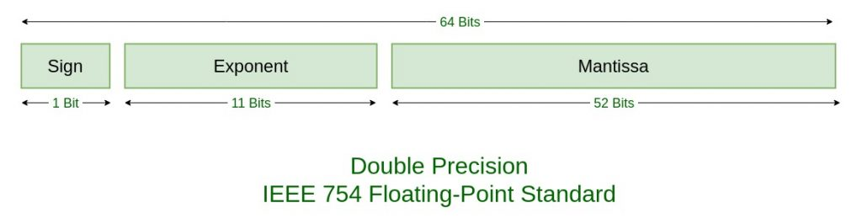
Double precision numbers have an 11-bit exponent field and a 52-bit fraction, for a total of 64 bits.
The sign bit is 0 for positive numbers and 1 for negative numbers. The exponent range for normalized numbers is [−1022, 1023] for double precision.
2. Double precision:
biased exponent 1023+6=1029
1029 = 10000000101
Normalised mantissa = 010101001
we will add 0's to complete the 52 bits
The IEEE 754 Double precision is:
= 0 10000000101 0101010010000000000000000000000000000000000000000000

Slide 46
Algorithm for addition and subtraction of floating point numbers.

